Slide 1
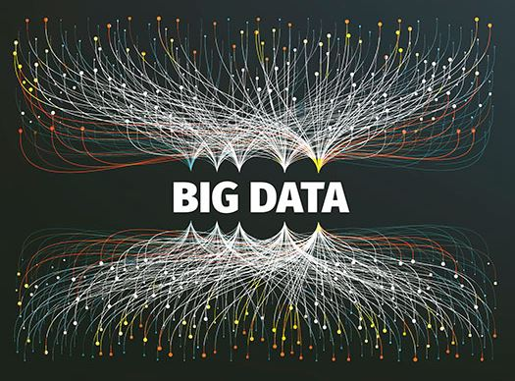
Cloud-enabled Data Science
By Jia, Lucas, Eric, Sunil

Slide 2
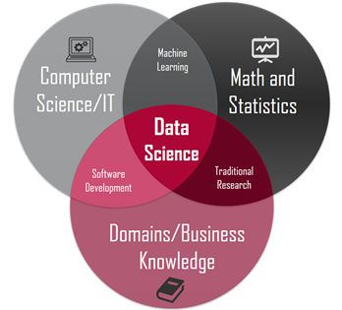

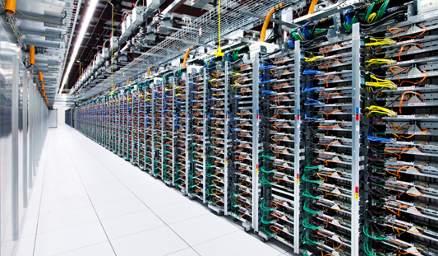
Making sense of data ….
… requires skill & computing resources

Slide 3
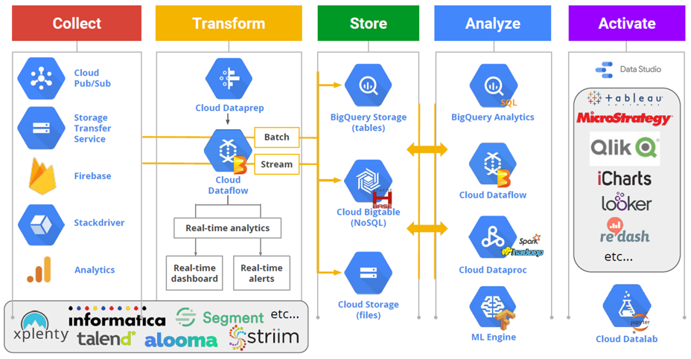
Cloud As A Key Enabler for Data Science

Slide 4

But there is one problem…
… cloud computing can get very expensive!!

Slide 5


Our mission (and we choose to accept it) is to build a cloud computing dashboard that provides insights into the usage and costs associated with the use of the cloud using data science

Slide 6
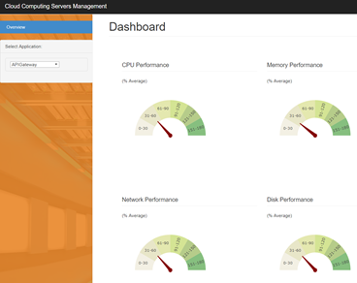
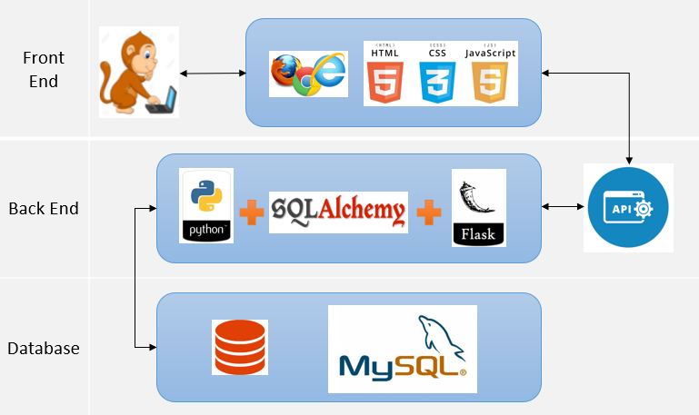
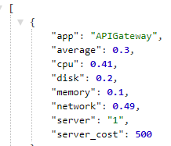
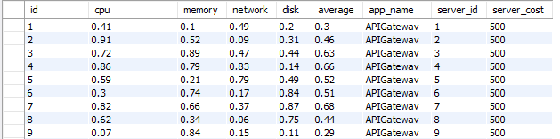
Application Diagram/ Structure

Slide 7

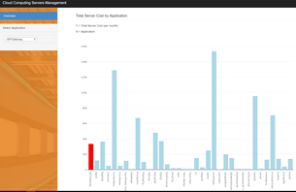

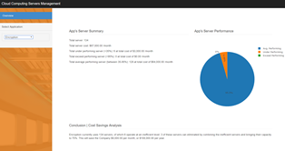
Dashboard App
Heroku Cloud:
https://data-analytics-p2.herokuapp.com/
GitHub Repo:
https://github.com/fanjia27/project_2_group_4

